Slide 1

In the name of Allah, the Most Merciful, the Most Kind
Assalam-o-alaikum,
A very warm welcome to Every one

Slide 2

Face Mask Detection
Group No 12
Hafiz Noor-Ur-Hassan ( BSCS-FA18-074 )
Advised by:
Anum Nawaz, Ph.D.
Department of Computer Science
The University of Faisalabad
anum.nawaz@tuf.edu.pk
June 15, 2021

Slide 3

AI vs ML vs DL

Slide 4
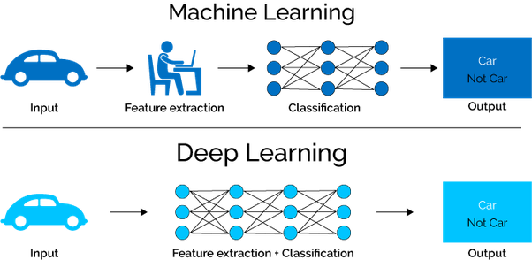
ML vs DL

Slide 5
Deep Learning
Deep learning is a machine learning technique that learns features and task directly from the data, where data may by images, text or sound!
Supervised Unsupervised Reinforcement Learning
Artificial Neural Network
Regression and Classification

Slide 6
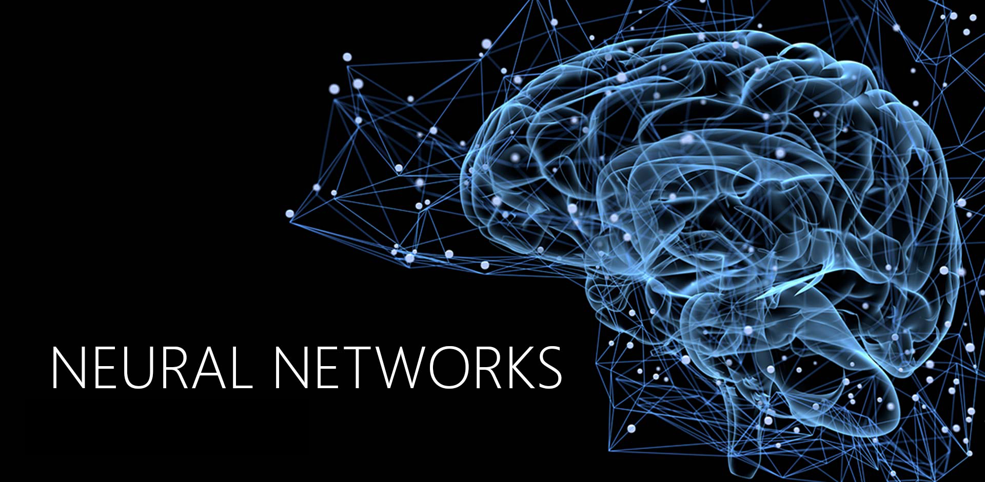
What is Neural?

Slide 7
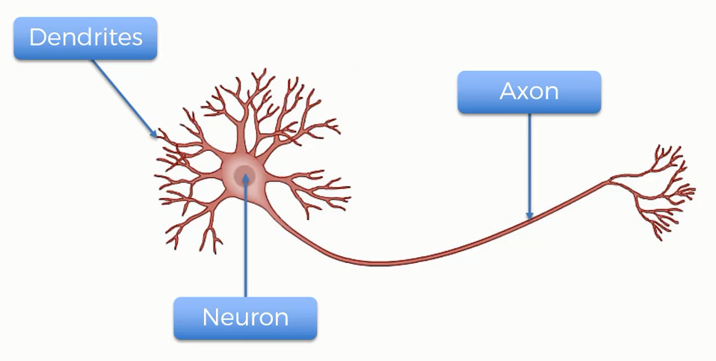
Neural Working

Slide 8
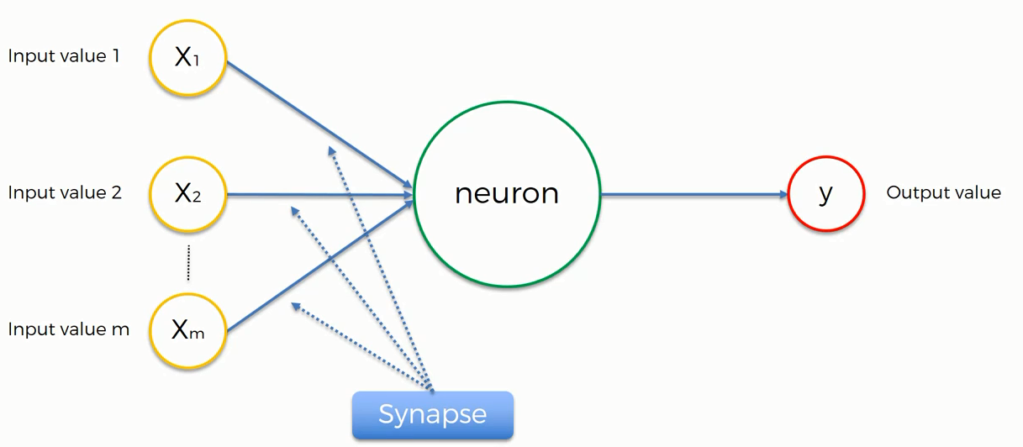
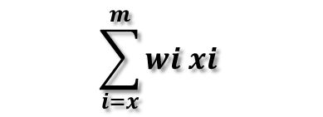
Perceptron in deep learning (ANN)
Normalize/Standardize
$$\sum_{i=x}^{m}{wi xi}$$
Applying Activation Function

Slide 9
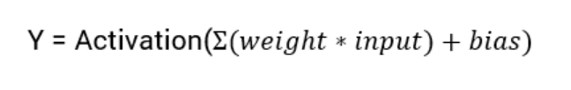
What is an Activation Function?
Activation functions are an extremely important feature of the artificial neural networks. They basically decide whether a neuron should be activated or not. Whether the information that the neuron is receiving is relevant for the given information or should it be ignored.
The activation function is the non linear transformation that we do over the input signal. This transformed output is then seen to the next layer of neurons as input.
Linear Activation Function
Non Linear Activation Function

Slide 10
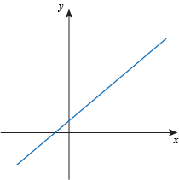
Type of Activation Function
Linear Function
The function is a line or linear. Therefore, the output of the functions will not be confined between any range
Threshold
Sigmoid
Tanh
ReLU
Leaky ReLU
SoftMax
Non Linear Function
They make it easy for the model to generalize or adapt with variety of data and to differentiate between the output
The Nonlinear Activation Functions are mainly divided on the basis of their range or curves.

Slide 11
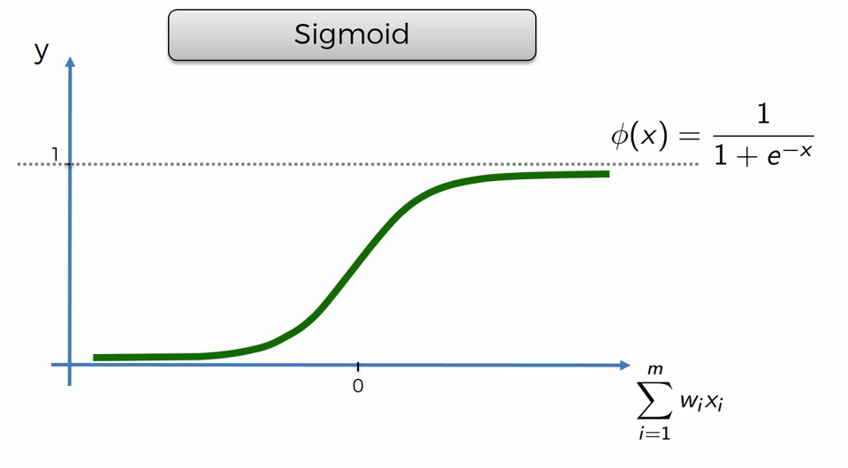
Sigmoid Function
The Sigmoid Function curve looks like a S-shape
This function reduces extreme values or outliers in data without removing them.
It converts independent variables of near infinite range into simple probabilities between 0 and 1, and most of its output will be very close to 0 or 1.

Slide 12
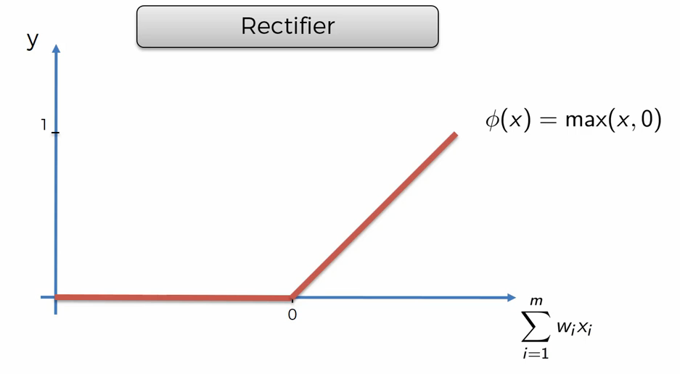
Rectifier (Relu) Function
ReLU is the most widely used activation function while designing networks today. First things first, the ReLU function is non linear, which means we can easily backpropagate the errors and have multiple layers of neurons being activated by the ReLU function.

Slide 13
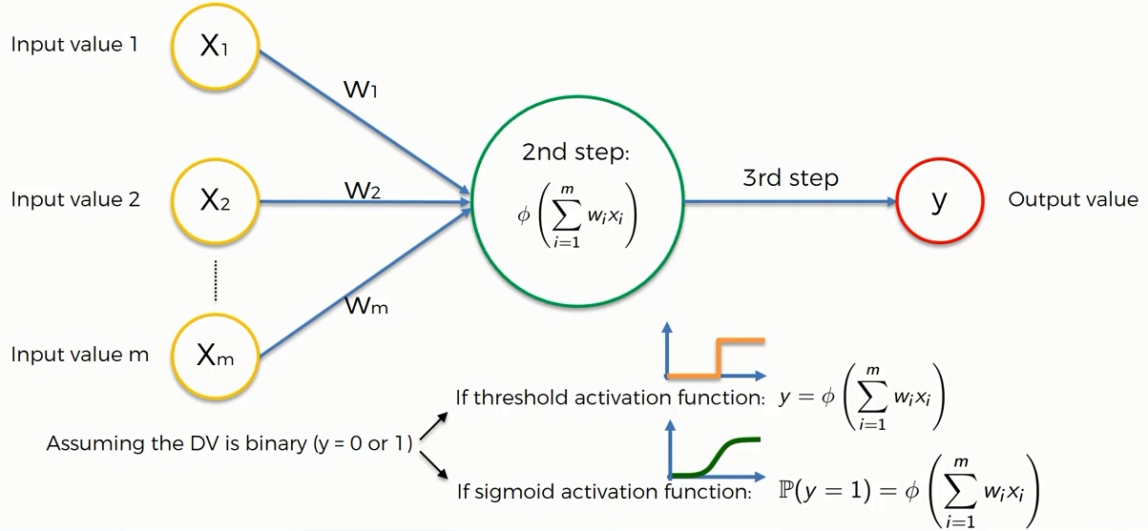
Activation Function Example

Slide 14
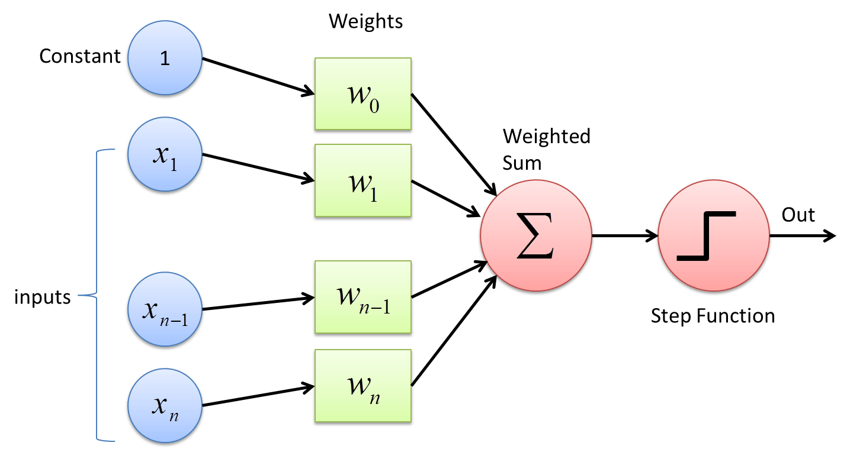
How Neural Network Work ?

Slide 15
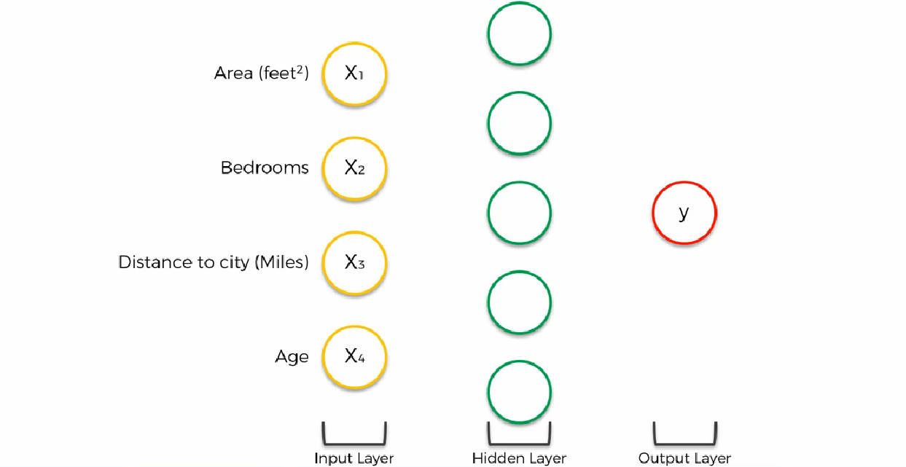
How Neural Network Work with many neurons ?

Slide 16
Back Propagation in deep learning
Back-propagation is the essence of neural net training. It is the method of fine-tuning the weights of a neural net based on the error rate obtained in the previous epoch (i.e., iteration). Proper tuning of the weights allows you to reduce error rates and to make the model reliable by increasing its generalization.
Backpropagation is a short form for "backward propagation of errors." It is a standard method of training artificial neural networks. This method helps to calculate the gradient of a loss function with respects to all the weights in the network.

Slide 17
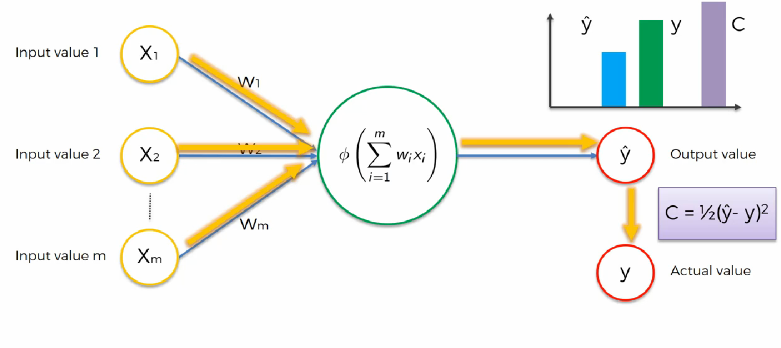
Back Propagation in deep learning (Cont.)

Slide 18
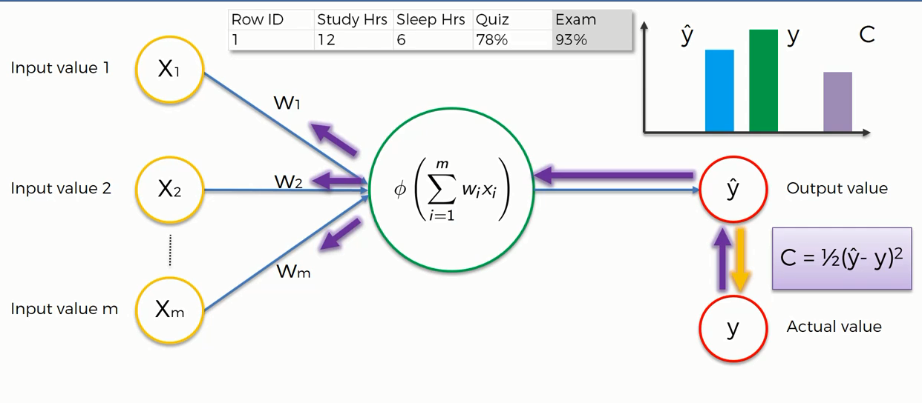
Back Propagation in deep learning (Cont.)

Slide 19
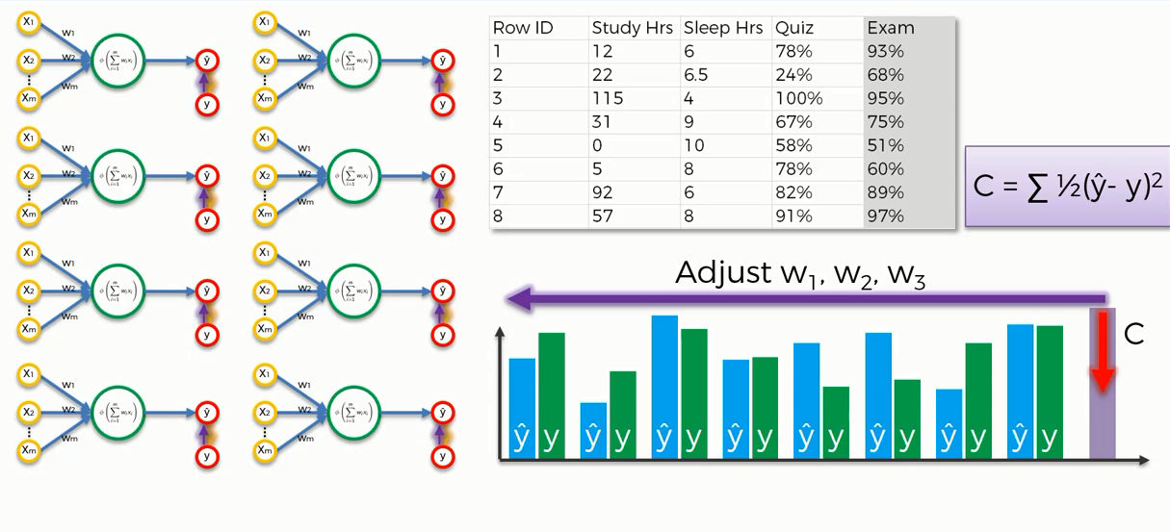
Back Propagation in deep learning (Cont.)

Slide 20
For further assistance Visit Stack Exchange
https://stats.stackexchange.com/questions/154879/a-list-of-cost-functions-used-in-neural-networks-alongside-applications

Slide 21
What is Bias ?
Bias is just like an intercept added in a linear equation. It is an additional parameter in the Neural Network which is used to adjust the output along with the weighted sum of the inputs to the neuron. Moreover, bias value allows you to shift the activation function to either right or left.
output = sum (weights * inputs) + bias
The output is calculated by multiplying the inputs with their weights and then passing it through an activation function like the Sigmoid function, etc. Here, bias acts like a constant which helps the model to fit the given data. The steepness of the Sigmoid depends on the weight of the inputs.
A simpler way to understand bias is through a constant c of a linear function.
y = mx + c

Slide 22
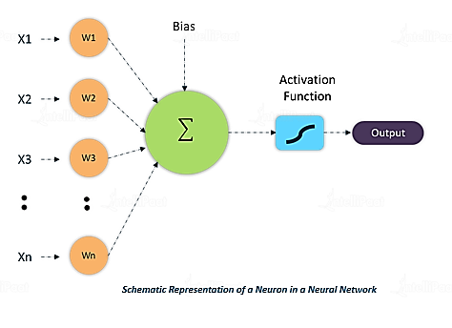
Bias (Cont.)
W * x + b

Slide 23
What is Optimizer ?
Optimizers are algorithms or methods used to change the attributes of your neural network such as weights and learning rate in order to reduce the losses.
Optimization algorithms or strategies are responsible for reducing the losses and to provide the most accurate results possible.
Role of an optimizer
Optimizers update the weight parameters to minimize the loss function. Loss function acts as guides to the terrain telling optimizer if it is moving in the right direction to reach the bottom of the valley, the global minimum.

Slide 24
Adaptive moment estimation or Adam Optimizer
Adaptive moment estimation, or Adam (2014), is a combination of momentum and RMSprop.
It acts upon,
The gradient component by using V, the exponential moving average of gradients (like in momentum) and
The learning rate component by dividing the learning rate α by square root of S, the exponential moving average of squared gradients (like in RMSprop).

Slide 25
Convolutional Neural Network (CNN)
Before understanding the CNN, lets understand first about these two core subject
Image processing is a method to perform some operations on an image, in order to get an enhanced image or to extract some useful information from it. It is a type of signal processing in which input is an image and output may be image or characteristics/features associated with that image.
Computer vision is a field of computer science that works on enabling computers to see, identify and process images in the same way that human vision does, and then provide appropriate output. It is like imparting human intelligence and instincts to a computer. In reality though, it is a difficult task to enable computers to recognize images of different objects.

Slide 26
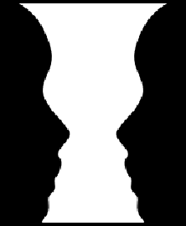

Convolutional Neural Network (Cont.)

Slide 27

But, the question arise, how will be learning in this stage?
Let’s understand the learning first about kids!

Slide 28
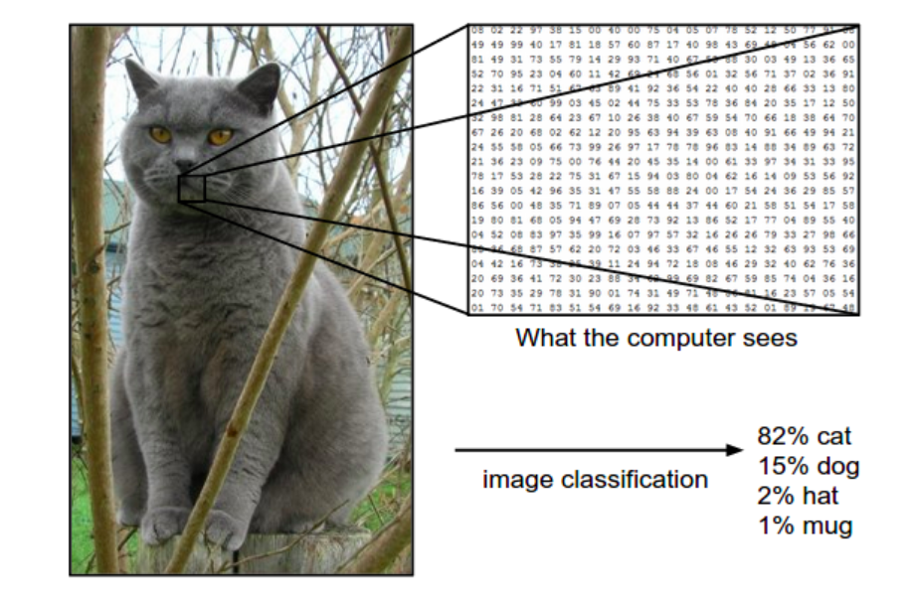
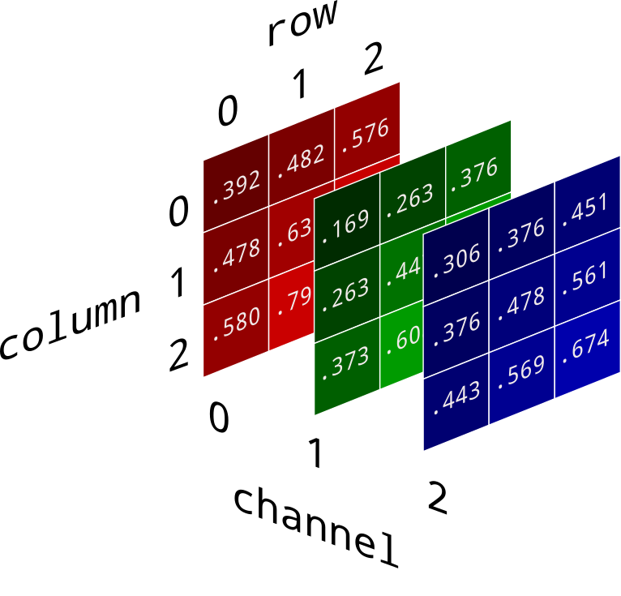
So, what about the Computer? CNN?
Learning… (by image features)
Gray scale image or RGB image

Slide 29
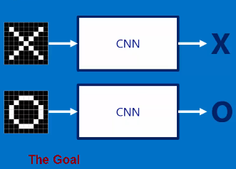
So, what about the Computer? CNN?
Learning…
X
O
Here CNN work as like black box, so what is inside the black box!

Slide 30
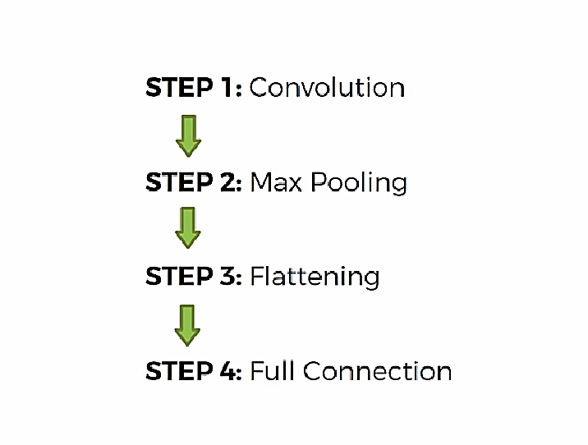
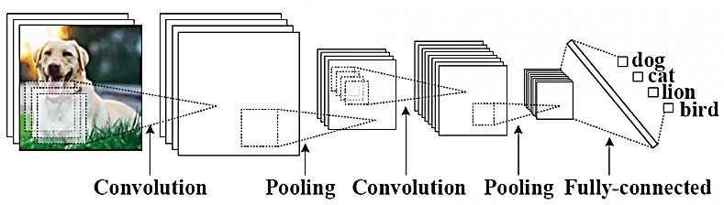
Steps in CNN

Slide 31
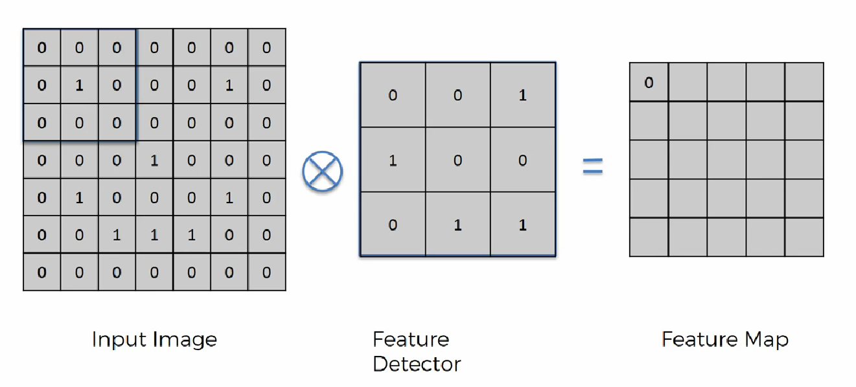
Convolutional ( of Smiling Face)

Slide 32
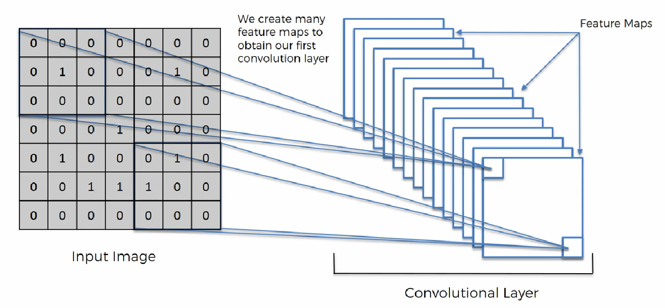
Convolutional (Cont.)

Slide 33
Convolutional (Cont.)
Different kind of filters / kernels in image processing!
http://setosa.io/ev/image-kernels/

Slide 34
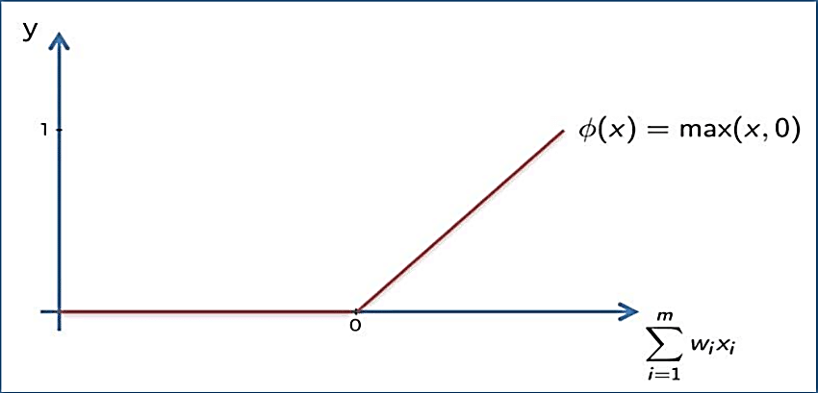
Convolutional (Cont.)
Appling ReLu Activation function to decrease the linearity in the image, because the image originally non linear!

Slide 35
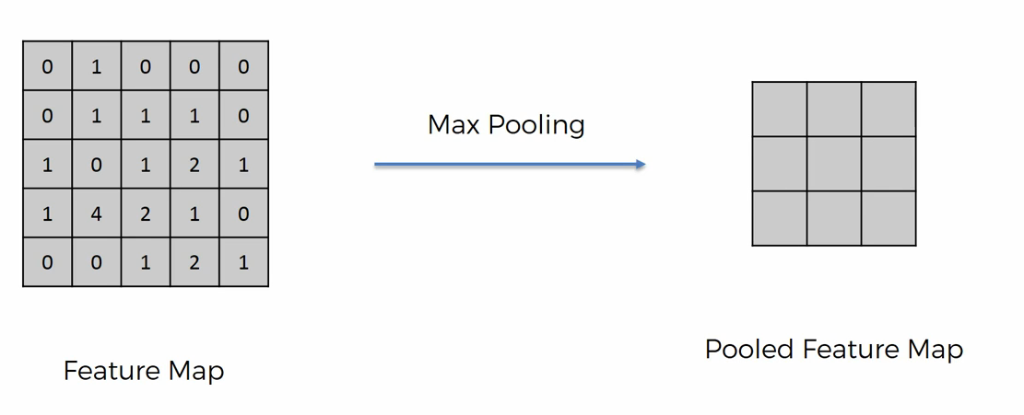
Pooling
A pooling layer is another building block of a CNN. Its function is to progressively reduce the spatial size of the representation to reduce the amount of parameters and computation in the network. Pooling layer operates on each feature map independently. The most common approach used in pooling is max pooling.

Slide 36
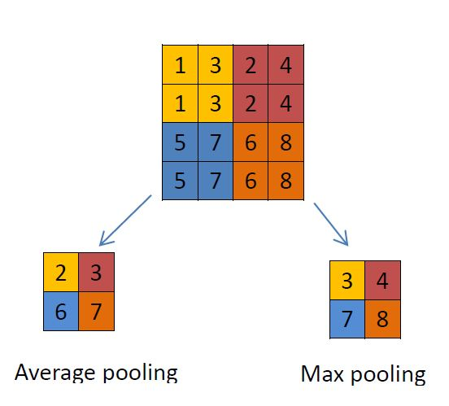
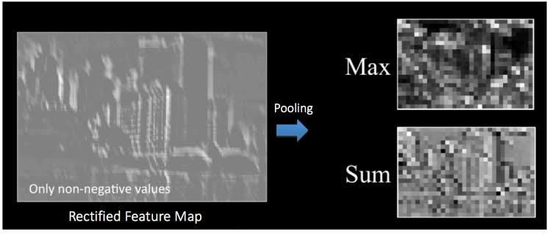
Max / Avg. Pooling

Slide 37
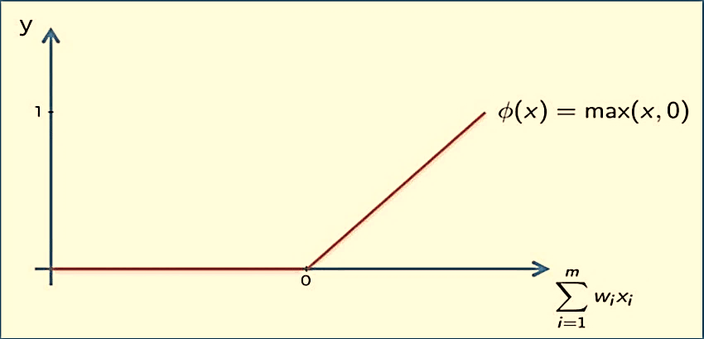
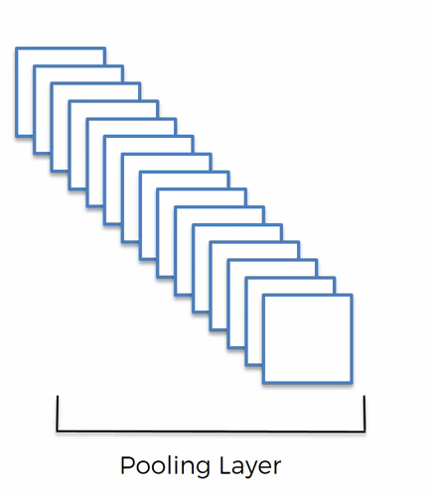
Pooling (Cont.)

Slide 38
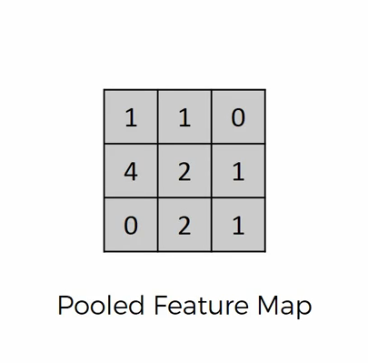
Flattening
Flattening is converting the data into a 1-dimensional array for inputting it to the next layer. We flatten the output of the convolutional layers to create a single long feature vector. And it is connected to the final classification model, which is called a fully-connected layer

Slide 39
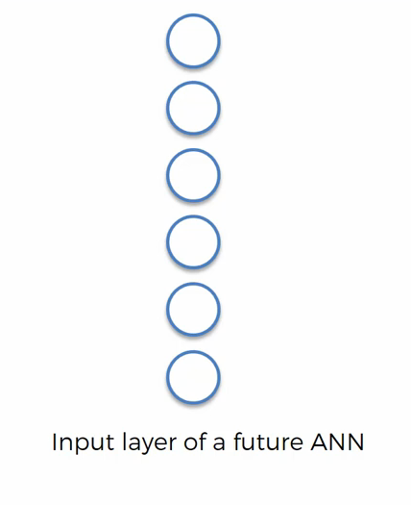
Flattening (Cont.)

Slide 40
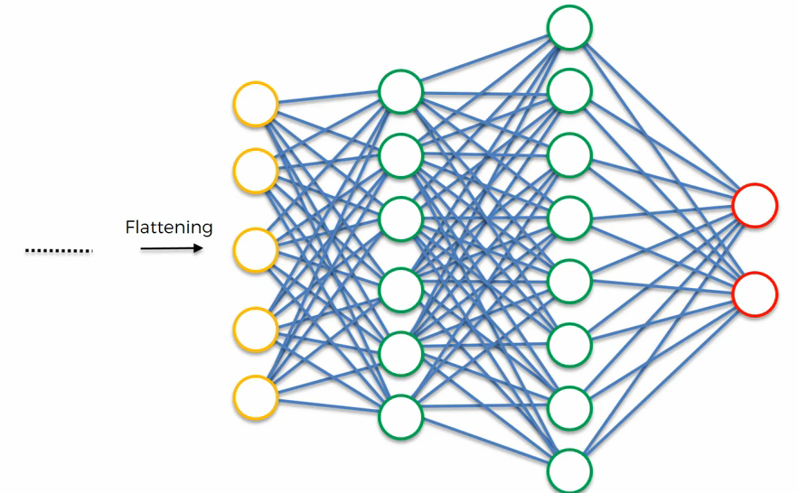
Fulling Connection
Mask
No Mask

Slide 41
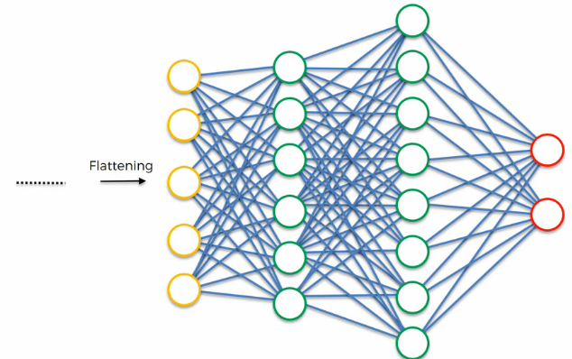
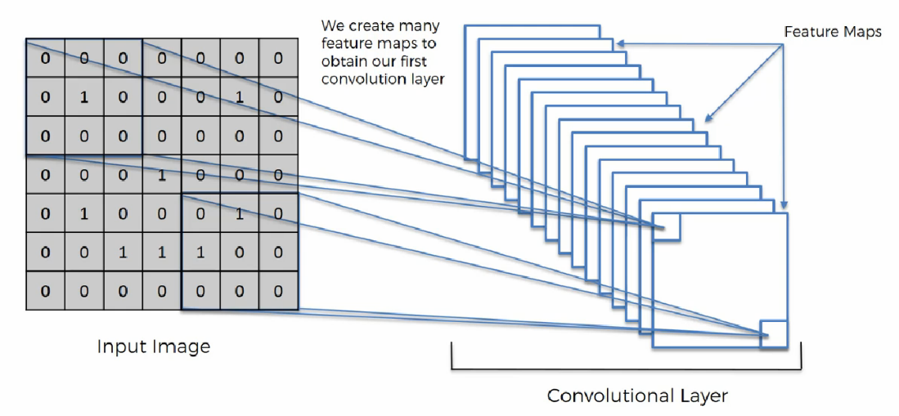
Complete CNN in one View
Mask
No Mask

Slide 42
TensorFlow
TensorFlow is a free and open-source software library for dataflow and differentiable programming across a range of tasks. It is a symbolic math library, and is also used for machine learning applications such as neural networks.

Slide 43
Keras
Keras is a high-level neural networks API, written in Python and capable of running on top of TensorFlow, CNTK, or Theano. It was developed with a focus on enabling fast experimentation. Being able to go from idea to result with the least possible delay is key to doing good research.
Use Keras if you need a deep learning library that:
Allows for easy and fast prototyping (through user friendliness, modularity, and extensibility).
Supports both convolutional networks and recurrent networks, as well as combinations of the two.
Runs seamlessly on CPU, GPU and TPU.

Slide 44
Any Question? Then Don’t ask Me 🙂

Slide 45
Now its time to,
Practical Working on Google COLAB

Slide 46
Thanks

